Slide 1

Project funded by the European Union
Project implemented by Expertise France
UN: Cyber norms
Abidjan September 2021
ORGANISED CRIME: WEST AFRICAN RESPONSE ON CYBERSECURITY AND FIGHT AGAINST CYBERCRIME
Projet ﬁnancé par
Mis en œuvre par

Slide 2
Introduction
Hein Dries:
  Key expert cybercrime OCWAR-C
  Council of Europe Expert
  EU, OSCE and others
Program:
  Brief history of most important norms
  UN and (!) beyond

Slide 3

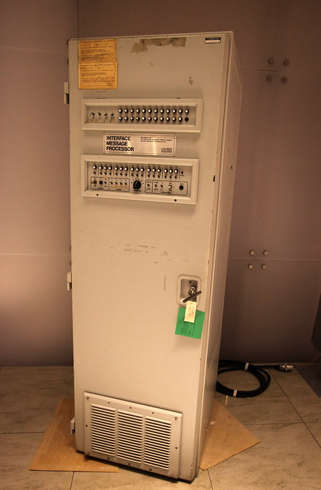

Early days
1969-199x:
Academic network
Limited need for “public law”

Slide 4
2000s
Cybercrime!
  Spam
  Adware
  Malware
  Fraud (419!)
Budapest convention on Cybercrime (CETS 185): Council of Europe
  Negotiated in the Council of Europe
  Council of Europe != European Union
  International treatieas
  US signed 2006/ratified 2007
  Markable absentees: Russia (and China)
International debate: ICANN/IANA and the responsibility for the internet naming and numbering resources
UN: WSIS (ITU): bridging the digital divide

Slide 5
A brief history of the cybercrime convention 2001-2021
Budapest convention
  First (and currently only) treaty that clearly applies to « Cyber »
  66 State parties (2021)
Additional Protocols
  First: Xenophobia and Racsim
  Second: 2021! Deals with further enhancing the cooperation on digital evidence.
September 2021: 66 state parties, 11 « underway »

Slide 6
(West) Africa
ECOWAS Directive on Cybercrime 2011
  Directive C/DIR. 1/08/11 On fighting Cybercrime within ECOWAS
  Binding for ECOWAS members
  Largely overlaps substantive provions and procedural provisions of the Budapest convention
Malabo convention 2014 (African Union)
  African Union
  Cybercrime, Cybersecurity, Data Protection
  55 AU members / 14 Signatures / 8 Ratifications (2020)

Slide 7
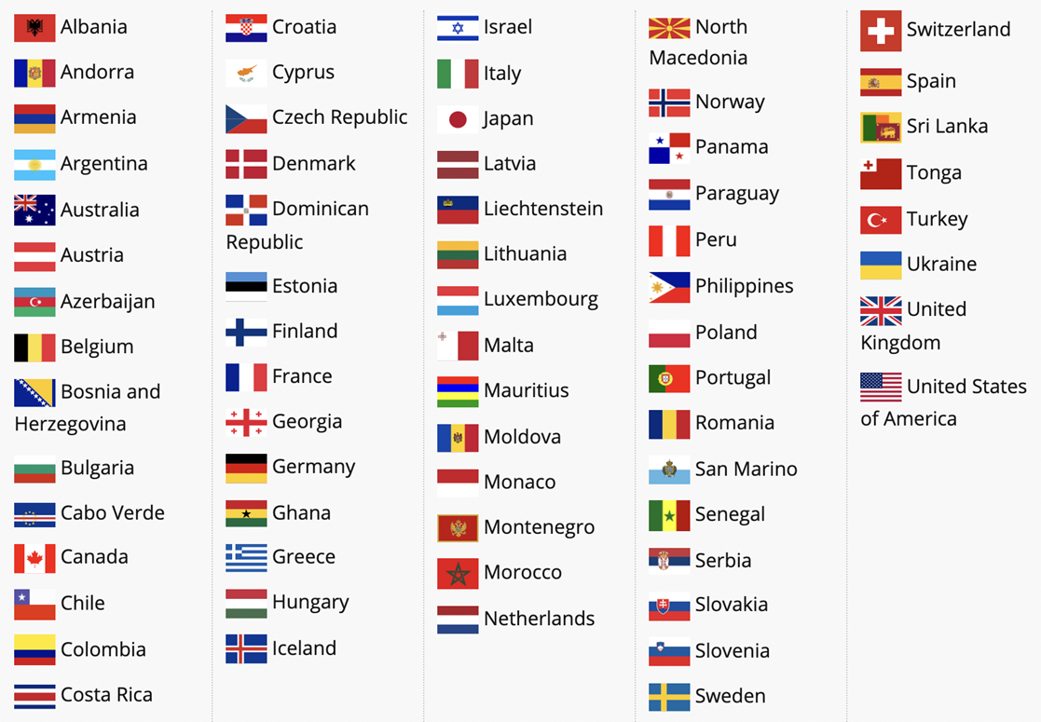
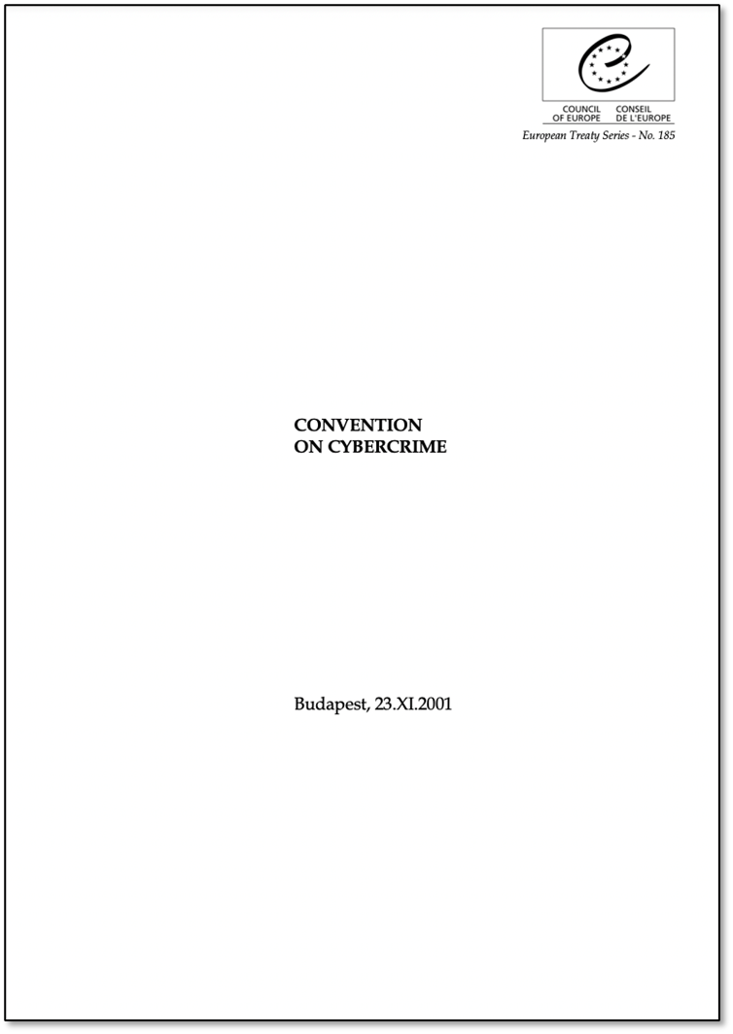
Budapest (and friends!)

Slide 8

Initial situation of the countries
Legal framework
MAURITANIA
MALI
NIGER
CABO VERDE
SENEGAL
THE GAMBIA
National legal framework
GUINEA
BISSAU
BURKINA FASO
Legal framework under elaboration
GUINEA
Malabo Convention
BENIN
Budapest Convention ratified
SIERRA
LEONE
TOGO
NIGERIA
Malabo + Budapest Convention ratified
COTE
D’IVOIRE
GHANA
No legal framework
LIBERIA

Slide 9
2010-2020
Attention shifts
  Increased attention to geopolitical aspects
  The issue of “spying” (Snowden, Wikipedia)
  Industrial Espionage (China-US summit: 2015)
International law on « cyber » conflict (cf: Tallinn Manual 1.0 and 2.0, UN)
  Use of force
  Non-intervention
  Attribution
2012: WICT – Dubai (ITU)
2015: Global conference on CyberSpace
  GFCE (next slide)
  Global Commission on the stability of cyberspace (now « retired »)

Slide 10
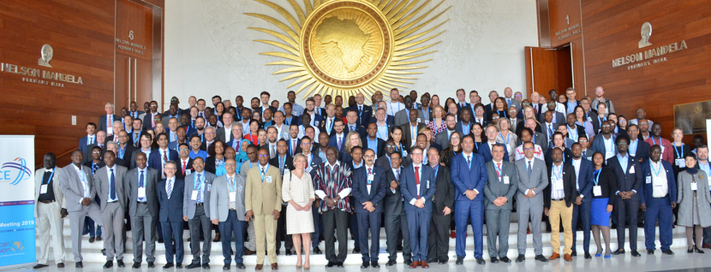
GFCE
Capacity building
  Clearing house
  Cybil portal
Working Groups on:
  Cybercrime
  Cyber security policy and strategy
  Incident management and Infrastructure Protection
  Cybersecurity Culture and Skills

Slide 11
2010-2020
OSCE and UN GGE:
  Concept of confidence building measures: CBMs
  Promote the Communication between rival countries (and “blocks”)
  OSCE CBMS (16 total):
    Sharing, providing and exchanging information
    Facilitating communications
    Steps to consider (such as national legislation)
    Way forward: Continuous development of CBMs
  UN GGE:
    Norms debate: Norms for responsible state behaviour
    2015 GGE: 11 Norms

Slide 12
2015 UN GGE/1
Limiting Norms ( “to omit”):
  states should not knowingly allow their territory to be used for internationally wrongful acts using ICTs;
  states should not conduct or knowingly support ICT activity that intentionally damages critical infrastructure;
  states should take steps to ensure supply chain security, and should seek to prevent the proliferation of malicious ICT and the use of harmful hidden functions;
  states should not conduct or knowingly support activity to harm the information systems of another state’s emergency response teams (CERT/CSIRTS) and should not use their own teams for malicious international activity;
  states should respect the UN resolutions that are linked to human rights on the internet and to the right to privacy in the digital age.
Positive Norms

Slide 13
2015 UN GGE/2
Positive Norms
  states should cooperate to increase stability and security in the use of ICTs and to prevent harmful practices;
  states should consider all relevant information in case of ICT incidents;
  states should consider how best to cooperate to exchange information, to assist each other, and to prosecute terrorist and criminal use of ICTs;
  states should take appropriate measures to protect their critical infrastructure;
  states should respond to appropriate requests for assistance by other states whose critical infrastructure is subject to malicious ICT acts;
  states should encourage responsible reporting of ICT vulnerabilities and should share remedies to these.
How did it go (Next slide)?

Slide 14
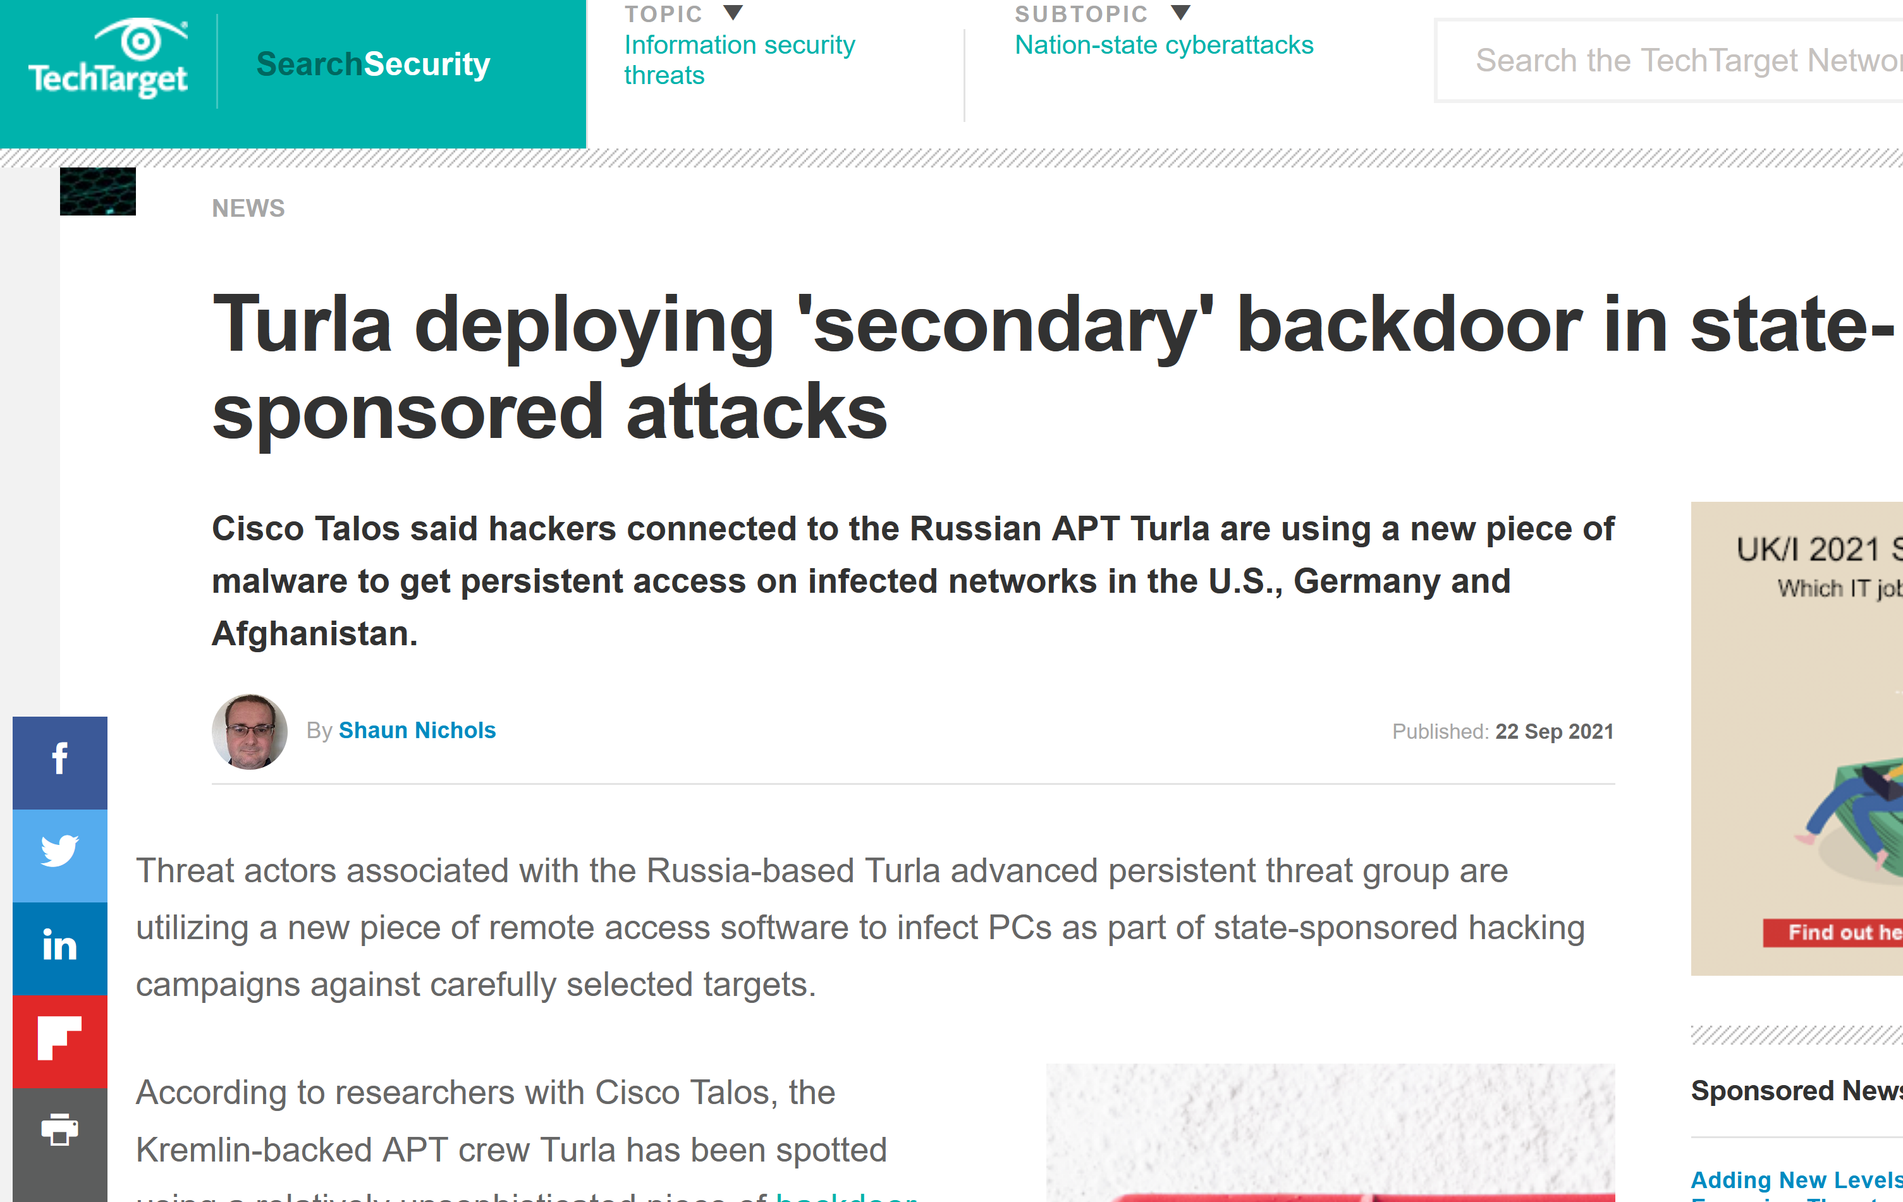
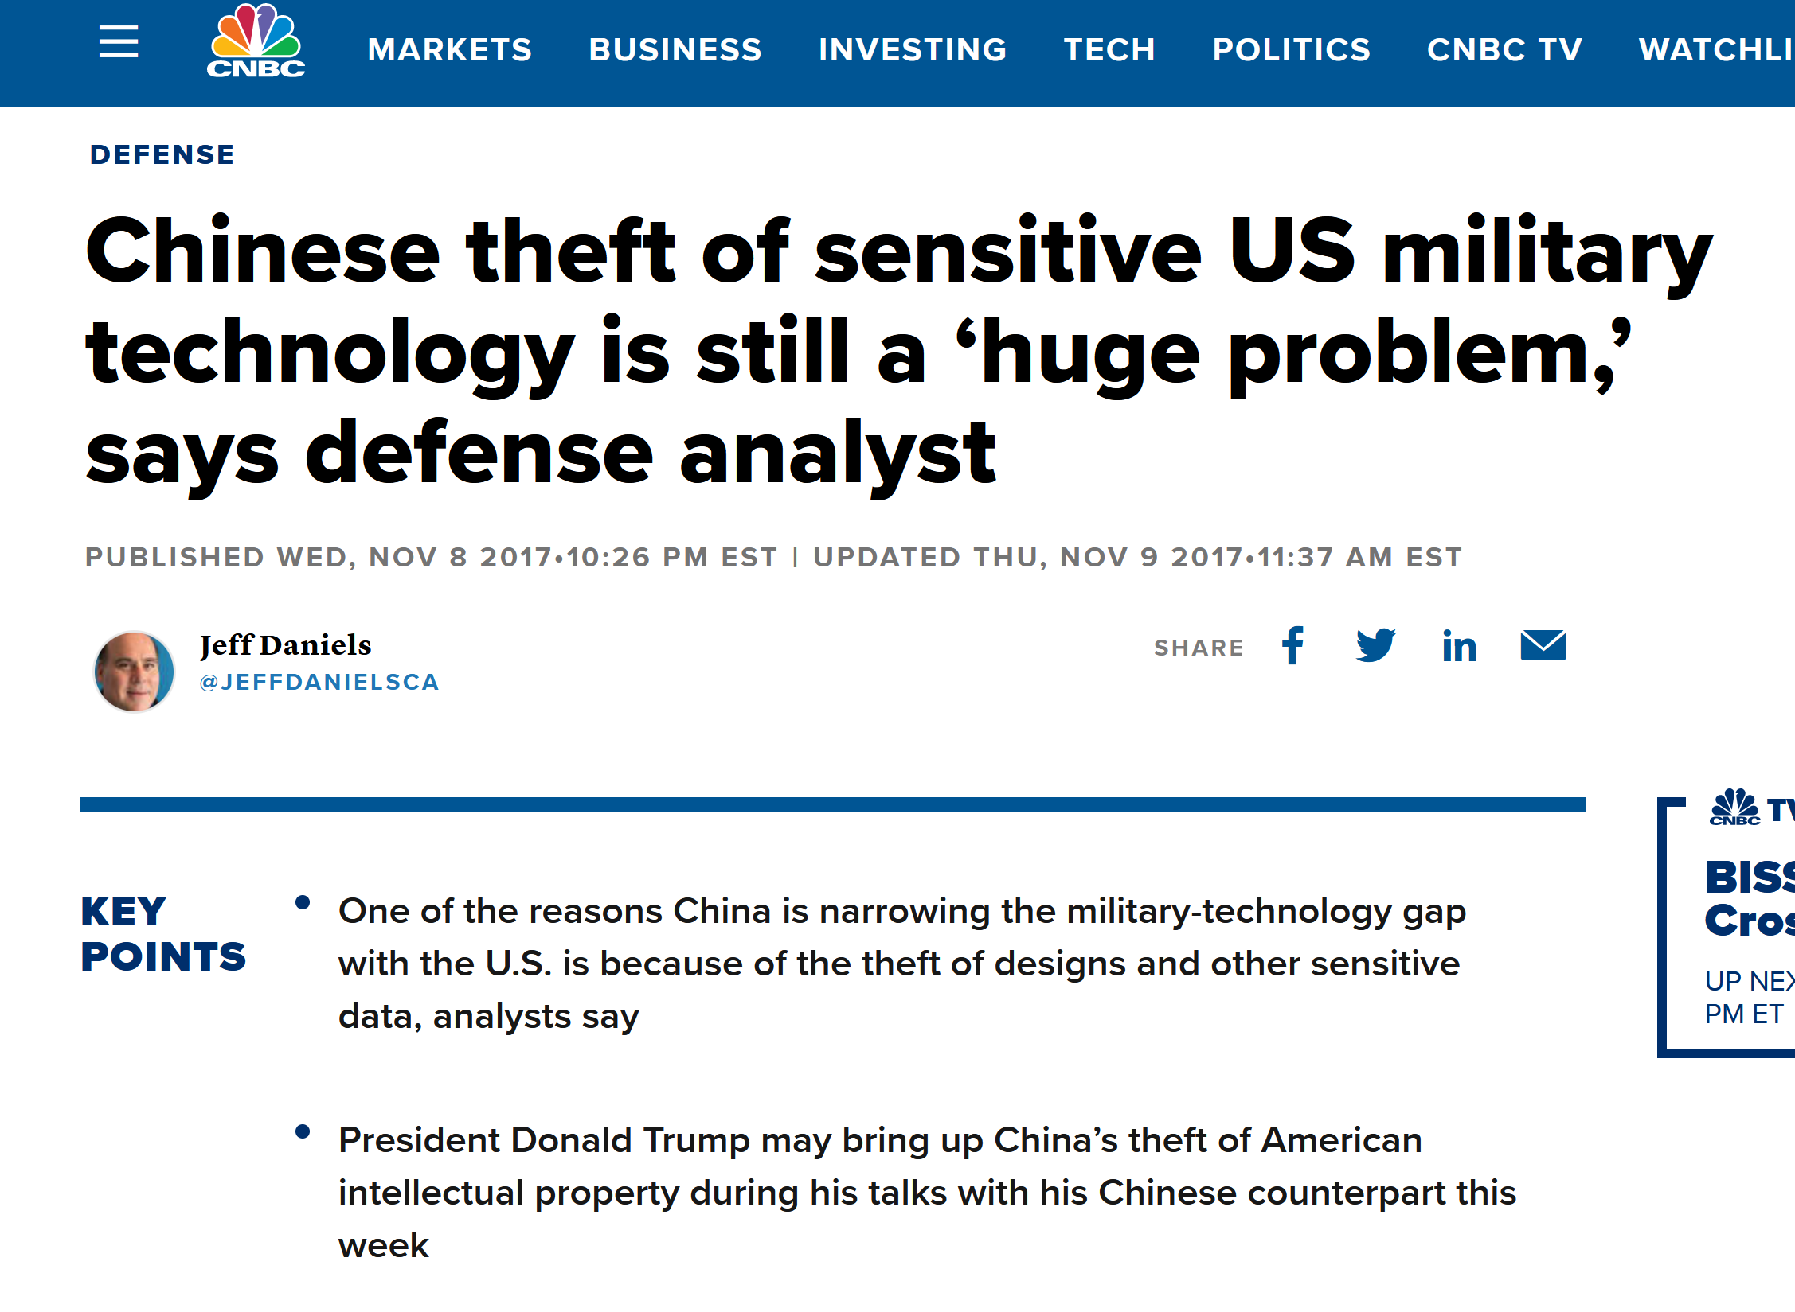
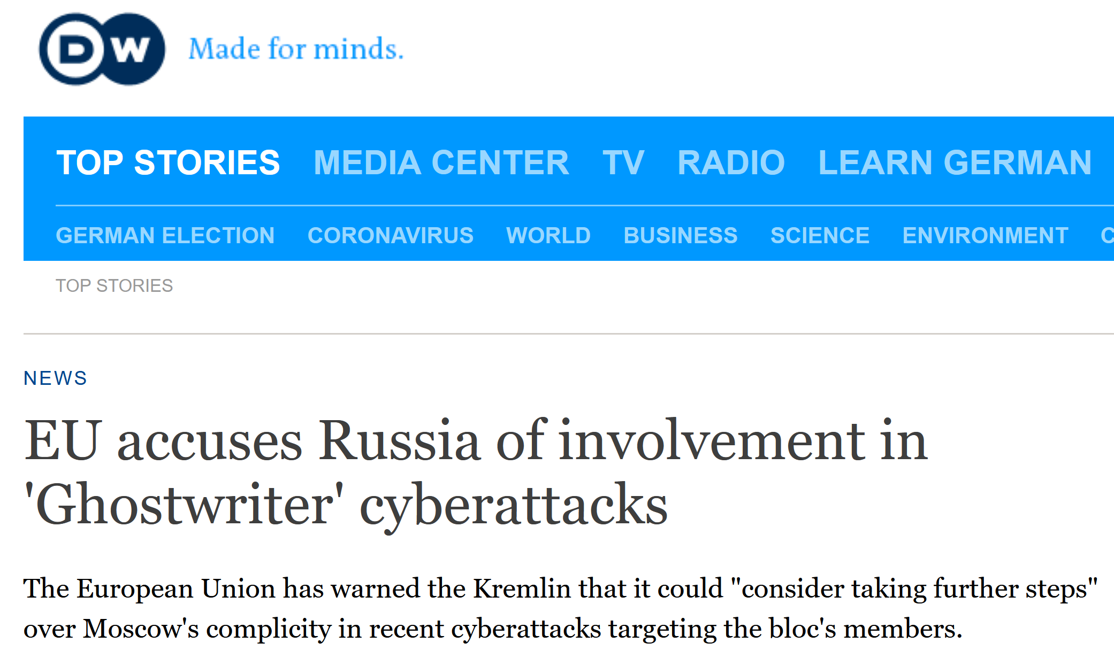
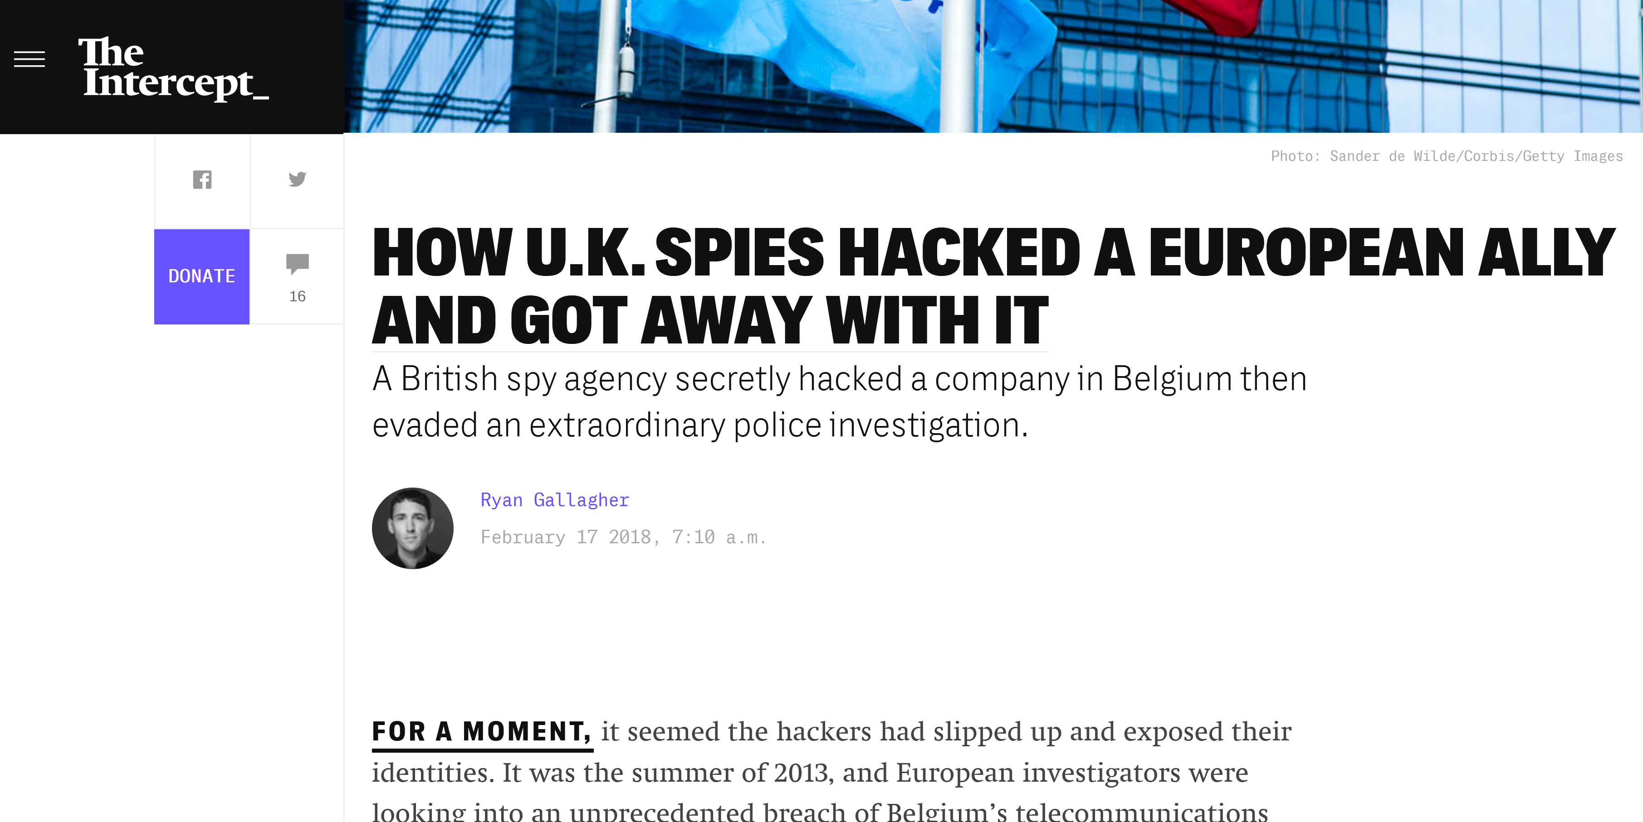
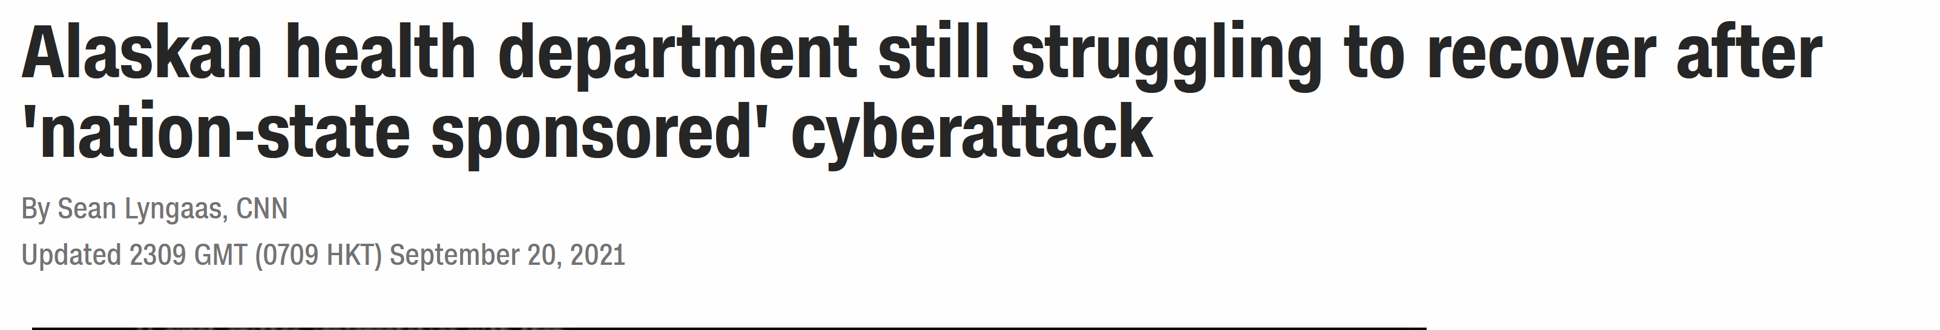
In the meantime

Slide 15
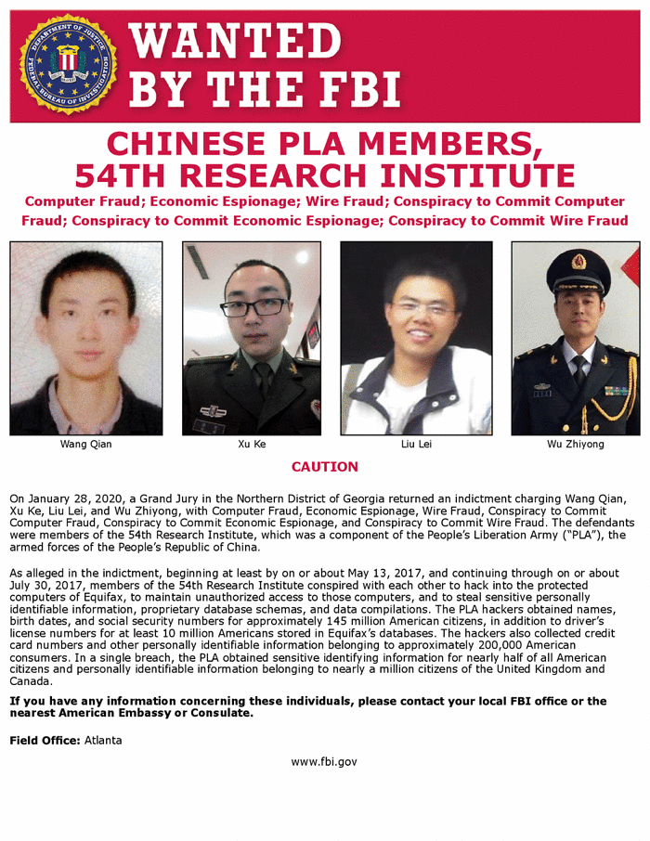
China-US-Russia?

Slide 16
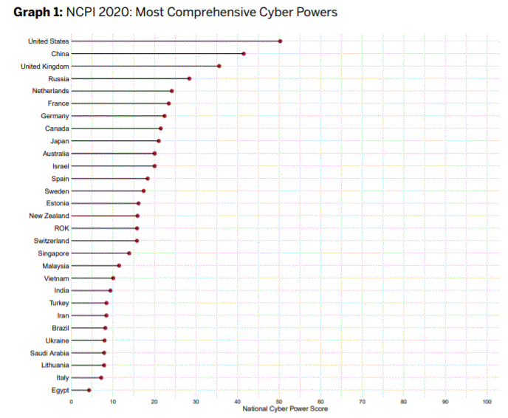
NCPI 2020

Slide 17
So lately in the UN…
Many subjects on the table: “International Cyber Policy”
UN processes:
  Open ended Working Group OEWG: abuse of ICT
  Final report of the 2021 GGE: additional explanations to GGE 2015
Issues:
  Norms for state Behaviour (GGE)…
  Negotiating a new convention regarding the abuse of ICT? (Ad Hoc Committee)

Slide 18

Questions? Discussion?

Slide 19

^{OCWAR-C}
12 Charles de Gaulle Street Asokoro,
^{Abuja - NIGERIA}
^{contact@ocwarc.eu}

